Slide 1
4483/8995 CAPSTONE PROJECT PRESENTATION
Gender Classification
Name: Yawen Wu
Student ID: U3256125
TUTORIAL GROUP – WEEK DAY/TIME: Thursday 14:30

Slide 2
Table of Contents
Introduction / Problem Statement
Dataset Details
EDA (Exploratory Data Analysis) Outcomes
PDA (Predictive Data Analytics) Outcomes
Implementation and Deployment (TkInter) Plan and Status Update
References/Bibliography

Slide 3
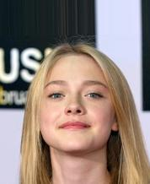
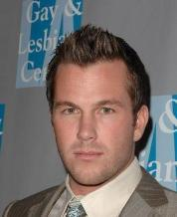
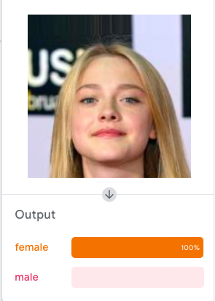
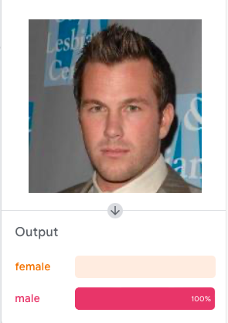
Introduction / Problem Statement

Slide 4





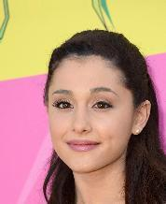

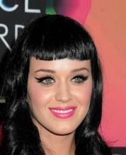
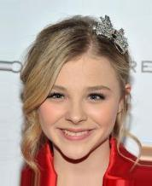

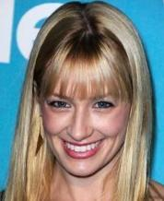
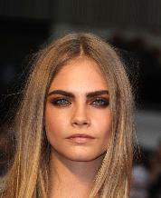
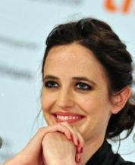
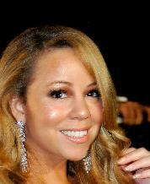
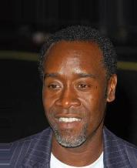



2. Dataset Details
The dataset consists of almost 200K images which are almost 1.3GB in size

Slide 5
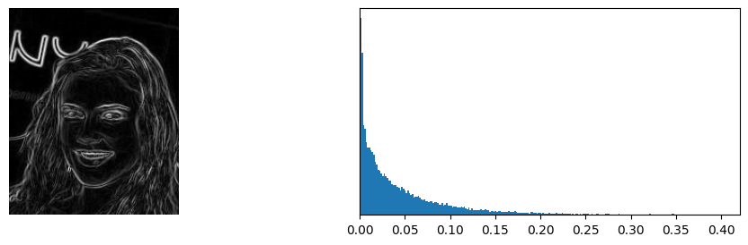
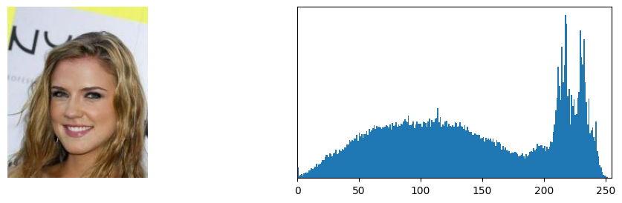
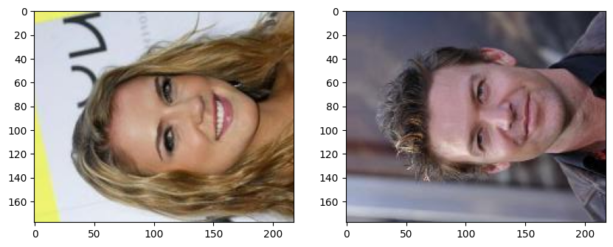
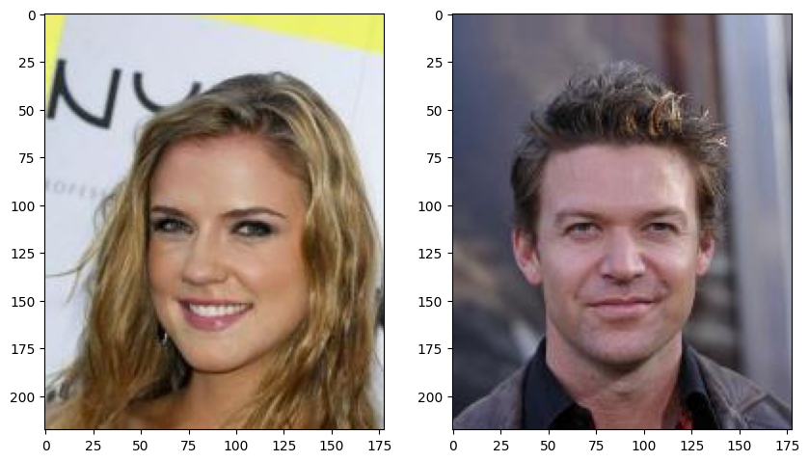
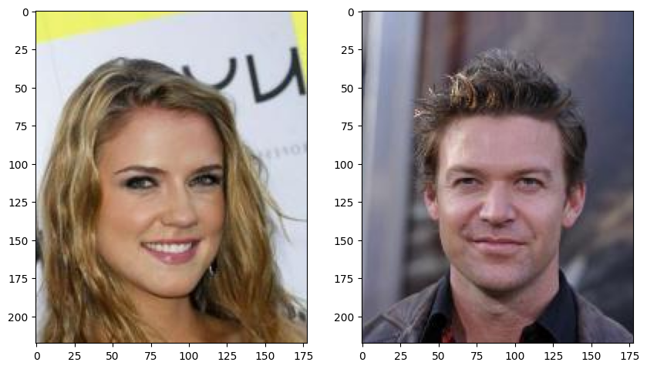
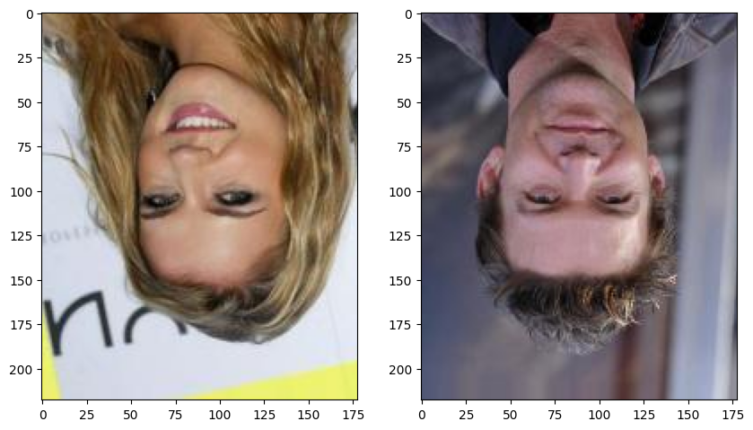
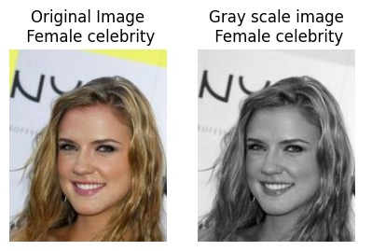
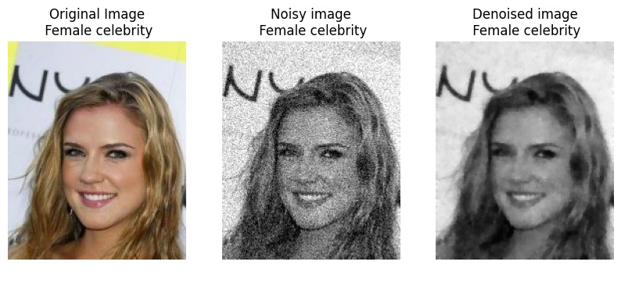
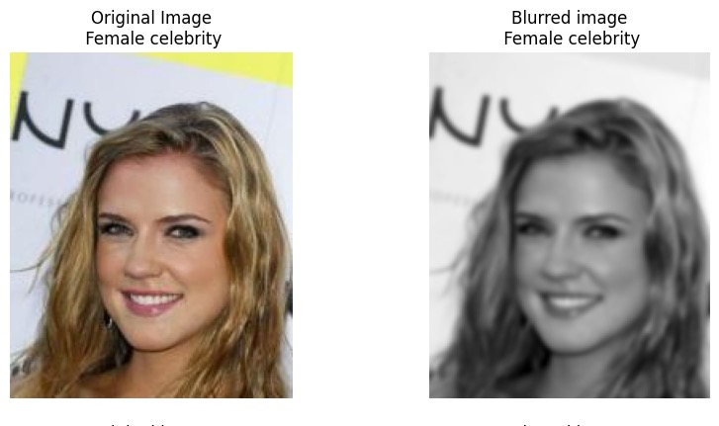
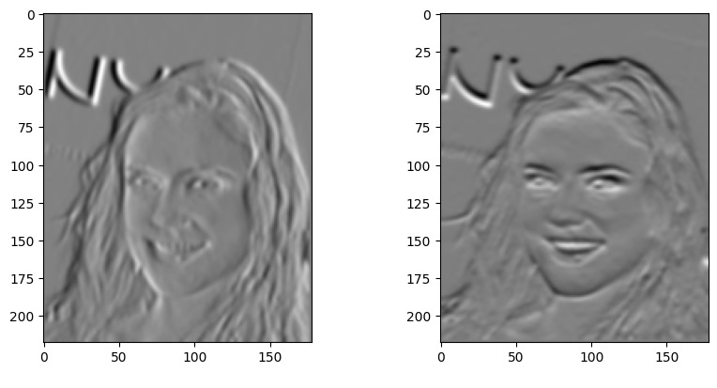
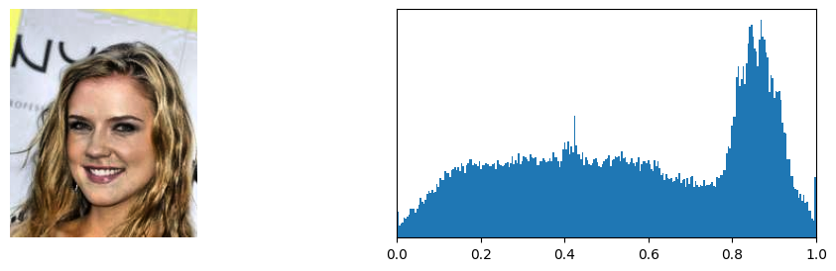
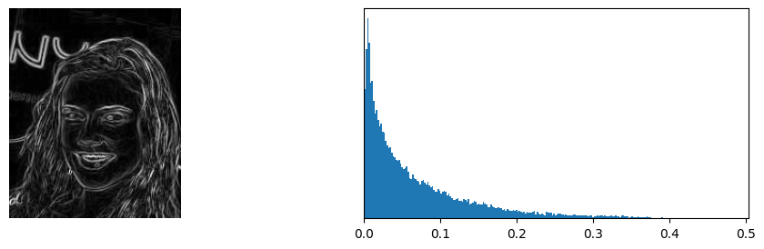
3. EDA (Exploratory Data Analysis) Outcomes

Slide 6
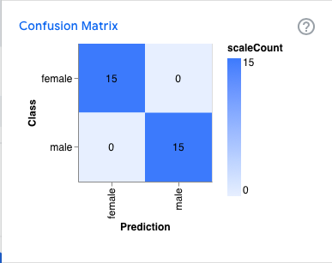
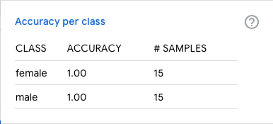
4. PDA (Predictive Data Analysis) Outcomes

Slide 7
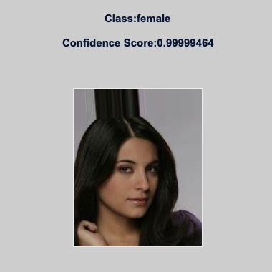
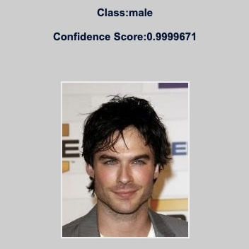
5. Implementation and Deployment (TkInter) Plan and Status Update

Slide 8
References /Bibilography
(https://www.kaggle.com/datasets/ashishjangra27/gender-recognition-200k-images-celeba )
(https://www.kaggle.com/datasets/jessicali9530/celeba-dataset )
Thank you!

